Slide 1

Innovathon’25
Team Name- Ice Age
Team Members-
Akarshan Gupta Harsh Hate Gaurav Thakur
Domain- Gen AI
Problem Statement- An AI-powered legal document processing system that simplifies language, summarizes content, extracts key terms, compares contracts, and analyzes risks.

Slide 2
Introduction We developed an AI-powered legal document processing system that allows users to upload legal documents and receive the following insights: -> Language Simplification – Converts complex legal jargon into plain, easy-to-understand language. -> Document Summarization – Generates concise summaries of lengthy legal documents. -> Key Terms Extraction – Identifies and highlights essential legal terms and clauses. -> Contract Comparison – Compares multiple contracts to identify similarities and differences. -> Risk Analysis – Evaluates potential risks and liabilities within the document. Additionally, the processed output can be translated into English, Hindi, or Marathi, ensuring accessibility across different linguistic backgrounds.

Slide 3
Objective -> Simplify Legal Document Understanding – Provide AI-driven insights for complex legal texts. -> Automate Document Summarization – Extract key information, saving time and effort. -> Improve Efficiency – Reduce manual review time using NLP-powered automation. -> Support Multi-Language Processing – Enable users to analyze legal documents in different languages. -> Ensure Scalability – Build a modular, scalable system for future enhancements.

Slide 4
Why LegalEase?
ChatGPT is a general AI that summarizes any text, but LegalEase is trained specifically on legal documents. This means it understands legal terms, clauses, and context better. LegalEase is optimized for legal documents, so it processes faster and highlights only the most important legal points—unlike ChatGPT, which may generate unnecessary details. LegalEase lets users choose the type of summary (detailed or key points). It can also explain difficult legal terms in simple words. LegalEase ensures data privacy and doesn’t store user documents, making it safer for legal professionals.

Slide 5
Challenges
Handling Complex Legal Language: Legal documents contain technical jargon, ambiguous phrases, and long sentences, making NLP processing challenging.
Ensuring High Accuracy of AI Predictions: Incorrect clause interpretation or summarization may lead to misleading legal insights.
Multi-Language Support Challenges: Translating legal documents while maintaining legal accuracy and context is difficult.
GPU & Computational Resource Constraints: Running large NLP models (like Transformers) requires high processing power.
Legal Compliance & Ethical Issues: AI-generated legal insights should not replace professional legal advice.

Slide 6
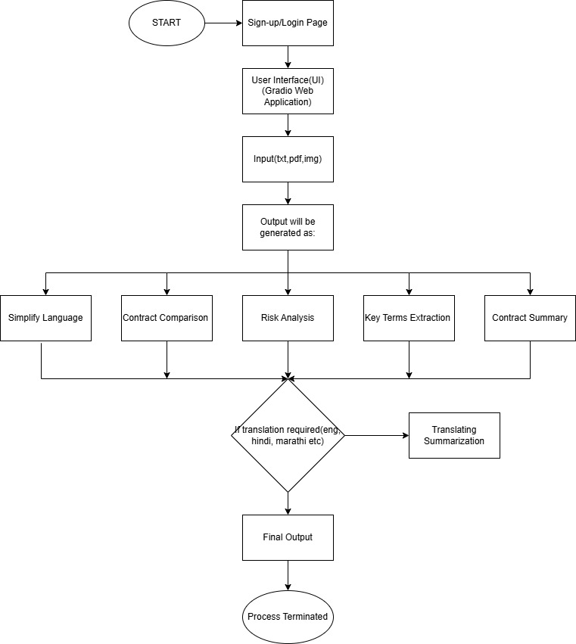
System Architecture

Slide 7
Tech-Stack
→ Front-end 💻: Gradio (for interactive UI)
→ Back-end 🗄️: Gemma-2B Model, Azure API Key
→ Translation Processing 🔄: CPU, GPU Acceleration

Slide 8
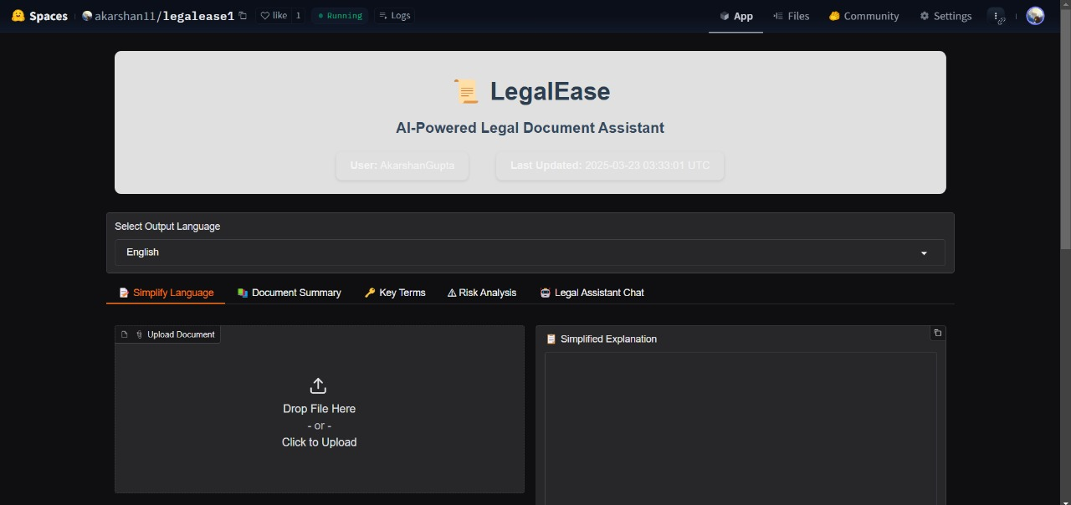
Result
Fig 1:
Interface

Slide 9
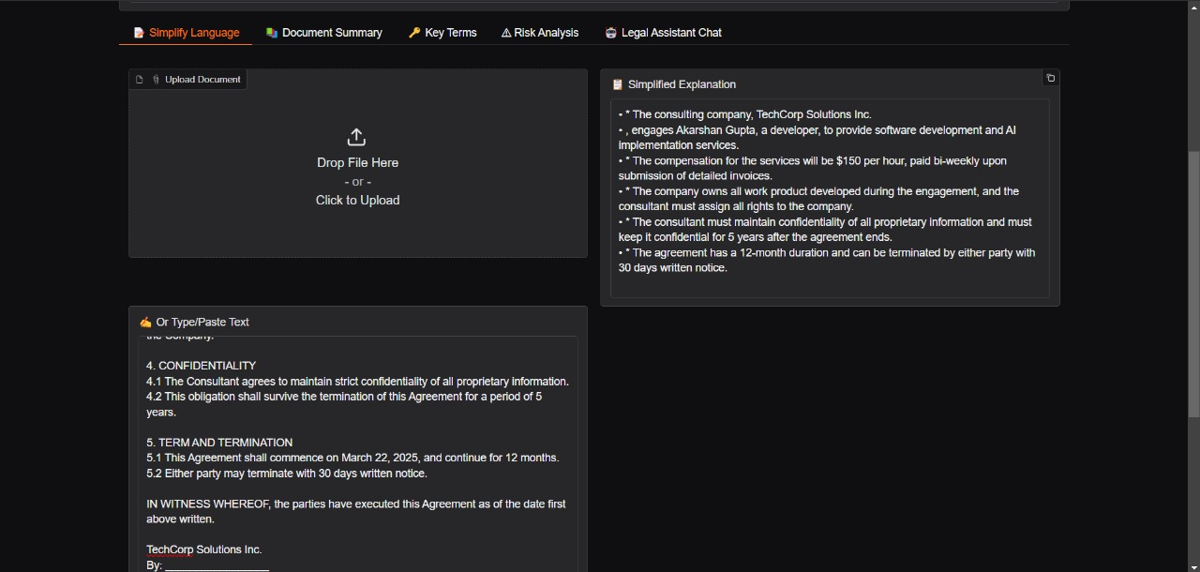
Fig 2: Language Simplification

Slide 10
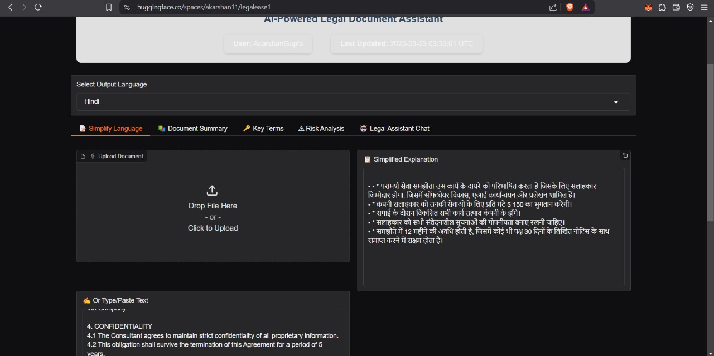
Fig 3: Translated Output

Slide 11
Future Scope
Reinforcement learning can be used for better throughput.
Integration with legal databases for real-time legal references.
Mobile app version for on-the-go access.
AI-powered chatbot to answer legal queries interactively.

Slide 12
Conclusion
Summarize key takeaways: ✅ AI-powered legal document assistant ✅ Saves time & effort ✅ Provides accessible legal insights ✅ Has huge potential for future improvements

Slide 13
Thank you
Team Ice Age
+91 9769691096
akarshanagupta@acpce.ac.in

